Slide 1
USING AI TO WRITE A STORY

Slide 2
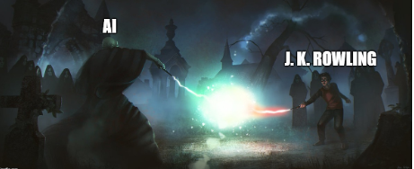

Slide 3
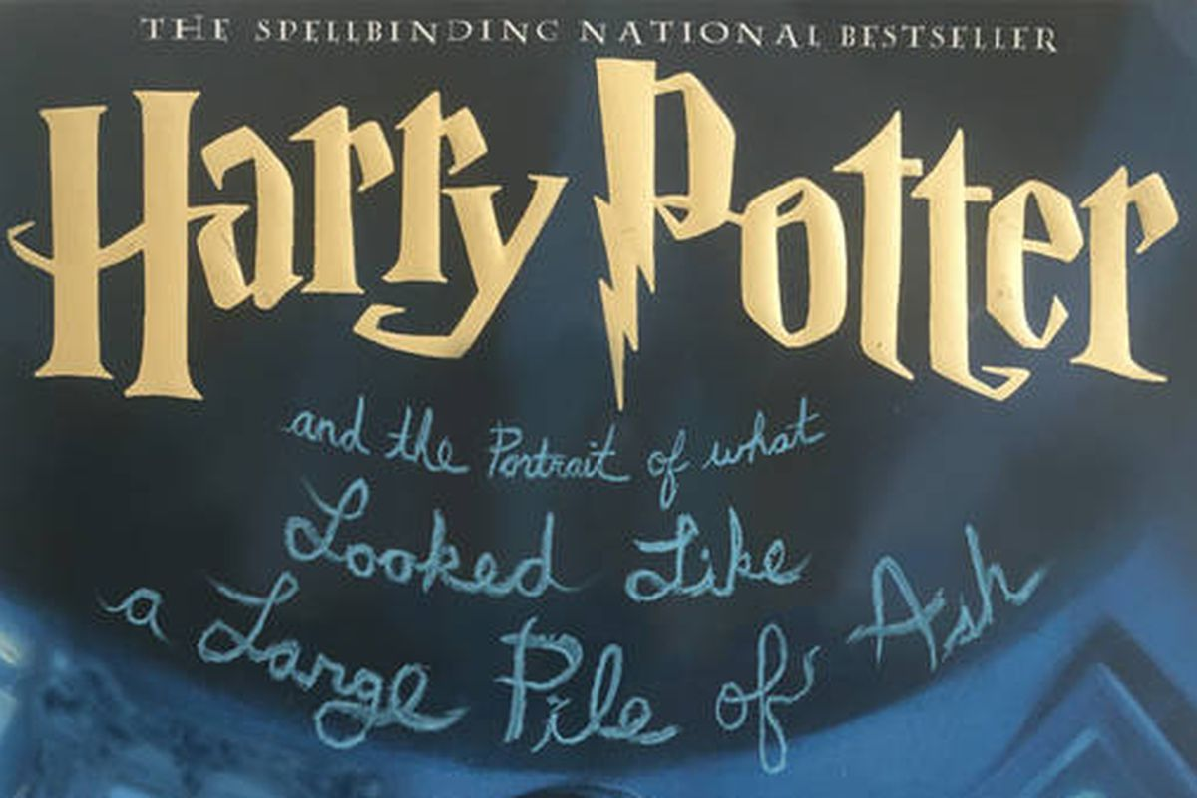
“Harry Potter and the Portrait of What Looked Like a Large Pile of Ash”

Slide 4
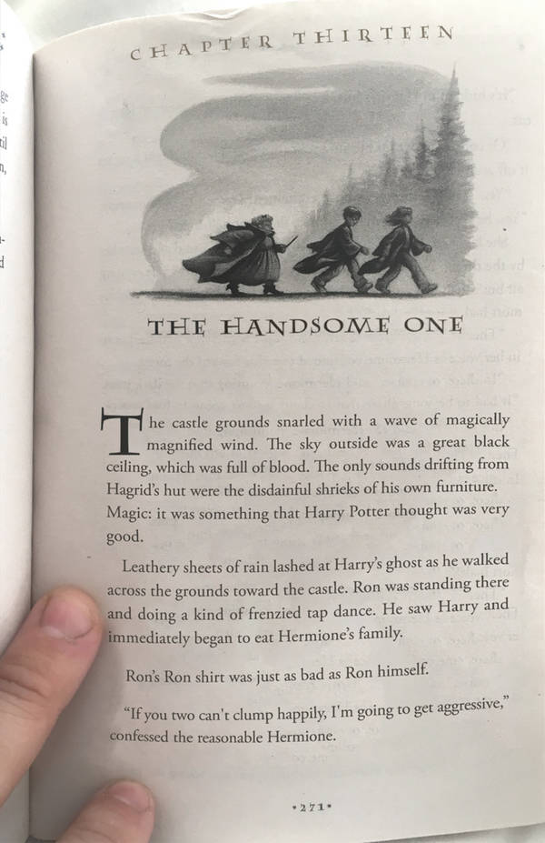
Botnik Studios
➔ A fost folosit predictive writer;
➔ Modelul a fost antrenat folosind primele 7 carti;
➔ Ce a iesit ?

Slide 5
Cum functioneaza neuronul uman?

